Slide 1


54 Years of Service

Slide 2
Topics to Cover
How we got here
What keeps the doors open
What we offer

Slide 3
How we got here
How we got here
What keeps the doors open
What we offer

Slide 4
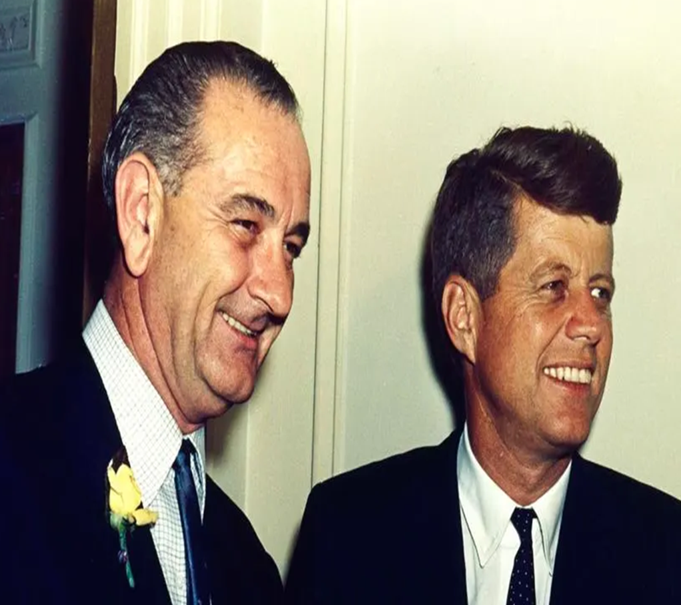
President Kennedy
and LBJ
President Kennedy had a personal connection to intellectual disabilities. His younger sister, Eunice Kennedy, was born with an intellectual disability.
He established and signed the Community Mental Health Act. Adopting a “system of care” for individuals with mental health and intellectual disabilities, instead of institutional care.
His Vice President was Lyndon Baines Johnson.

Slide 5
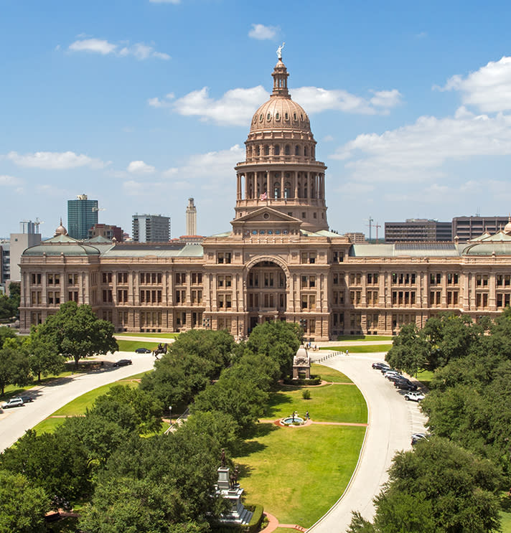
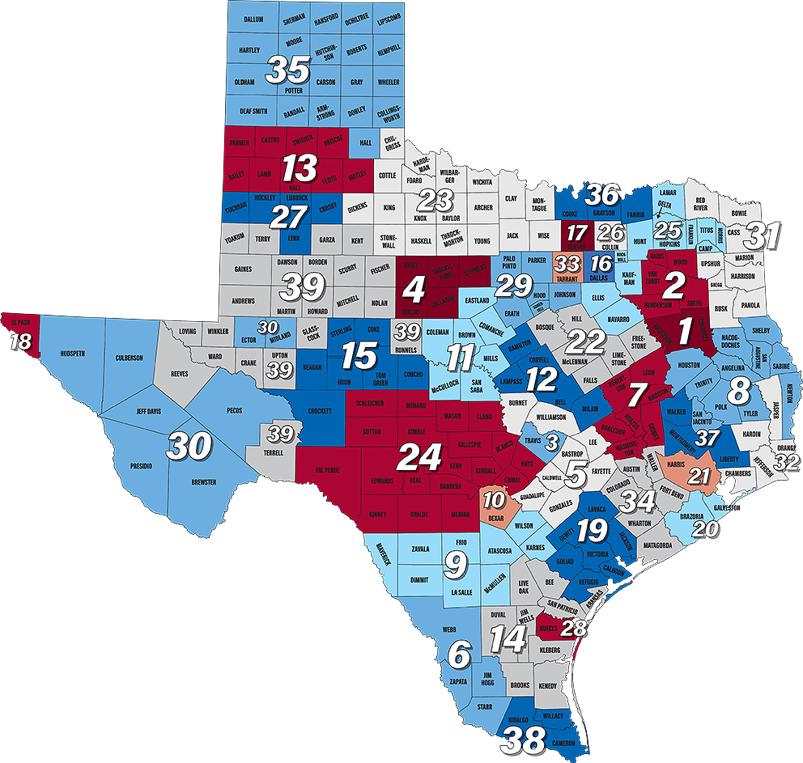




Texas Mental Health and Mental Retardation Act of 1965
.
There are 39 Centers in Texas that cover all 254 counties.

Slide 6
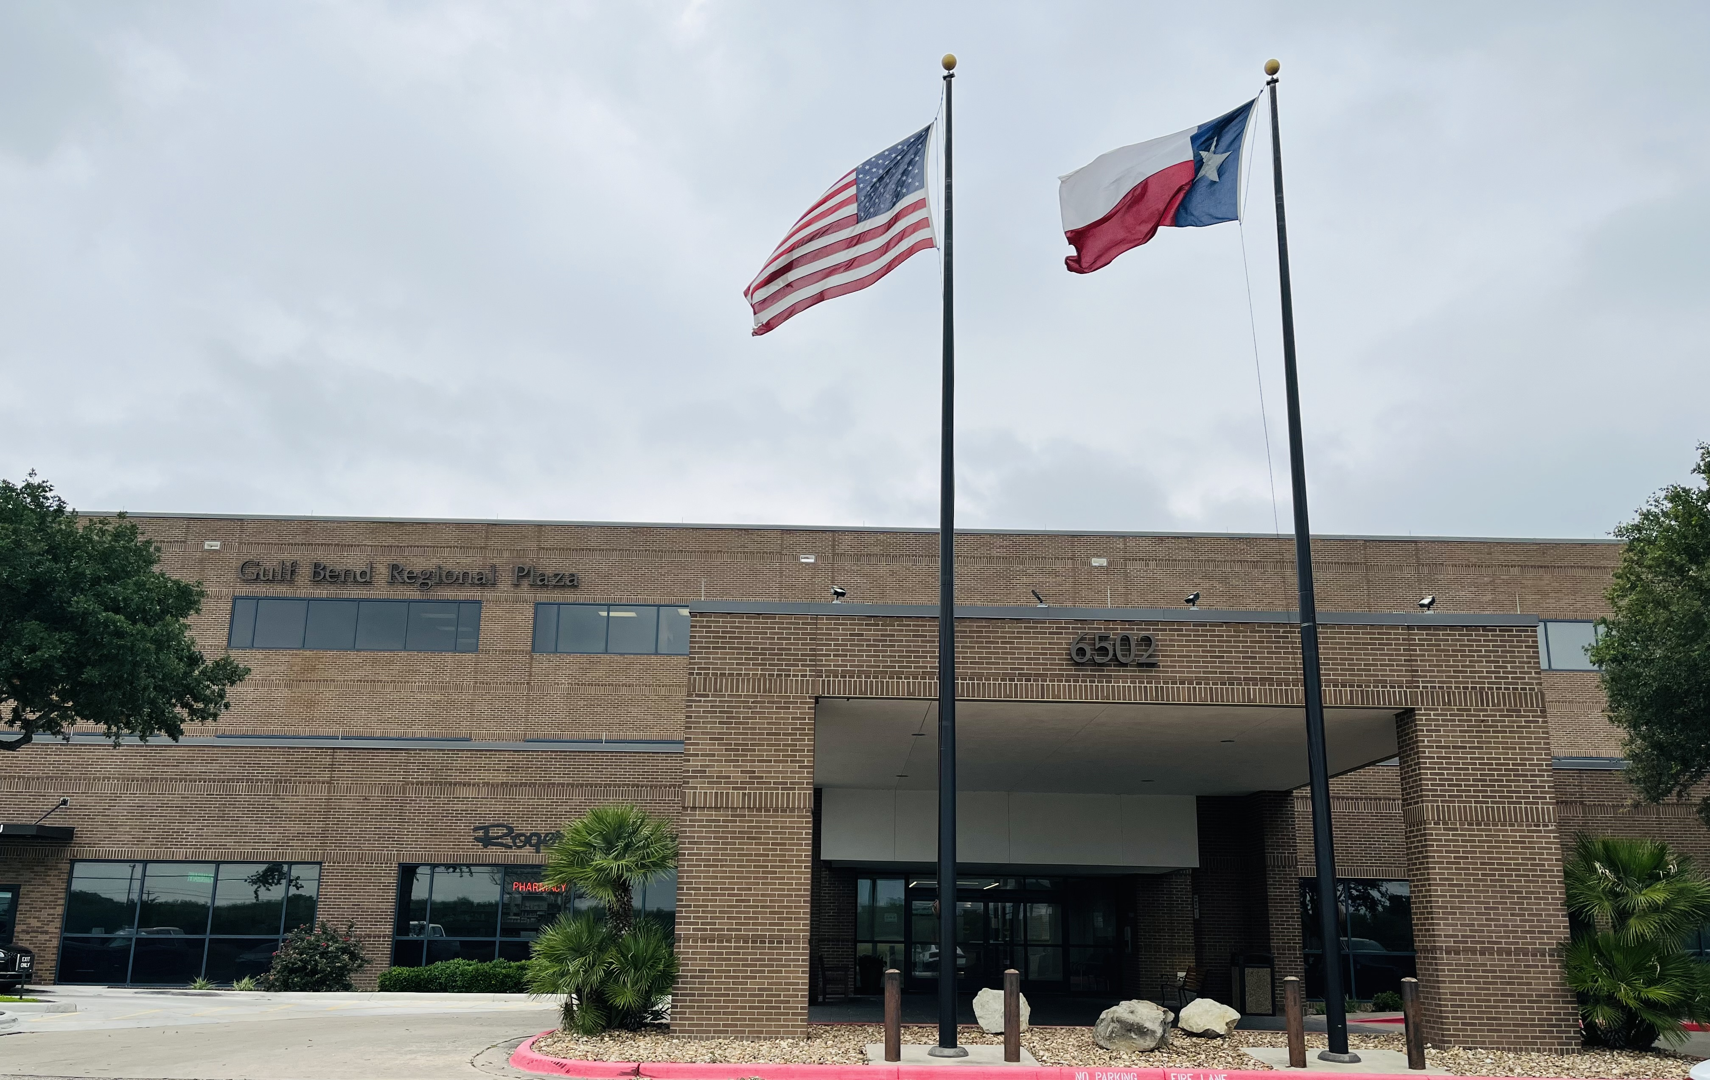
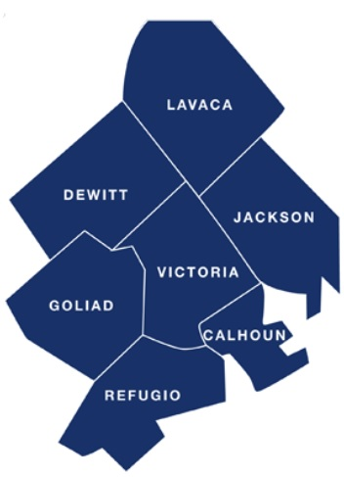
Gulf Bend Center was established in 1970, providing services to DeWitt, Victoria, Jackson, Calhoun, Goliad, and Refugio Counties. Lavaca County was added in 1974.

Slide 7
What keeps the doors open
How we got here
What keeps the doors open
What we offer

Slide 8
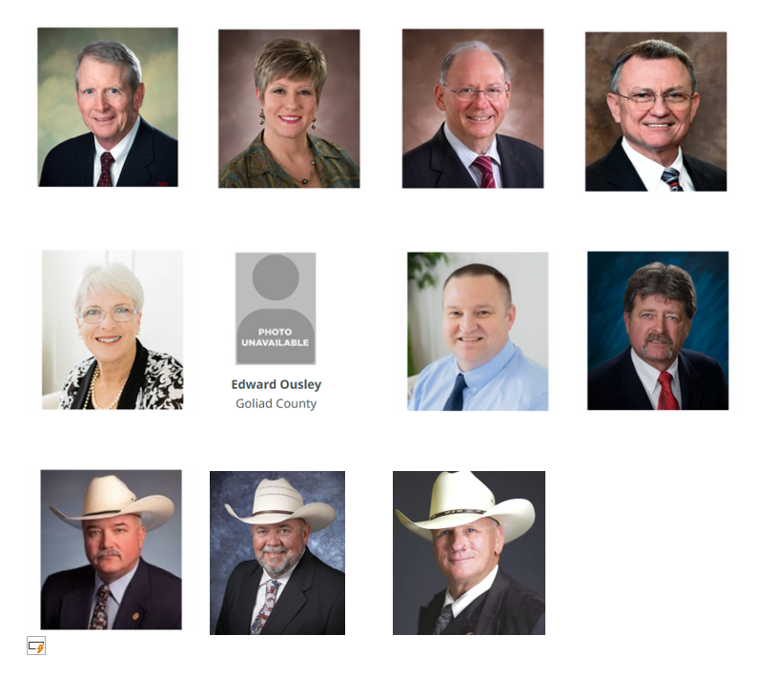
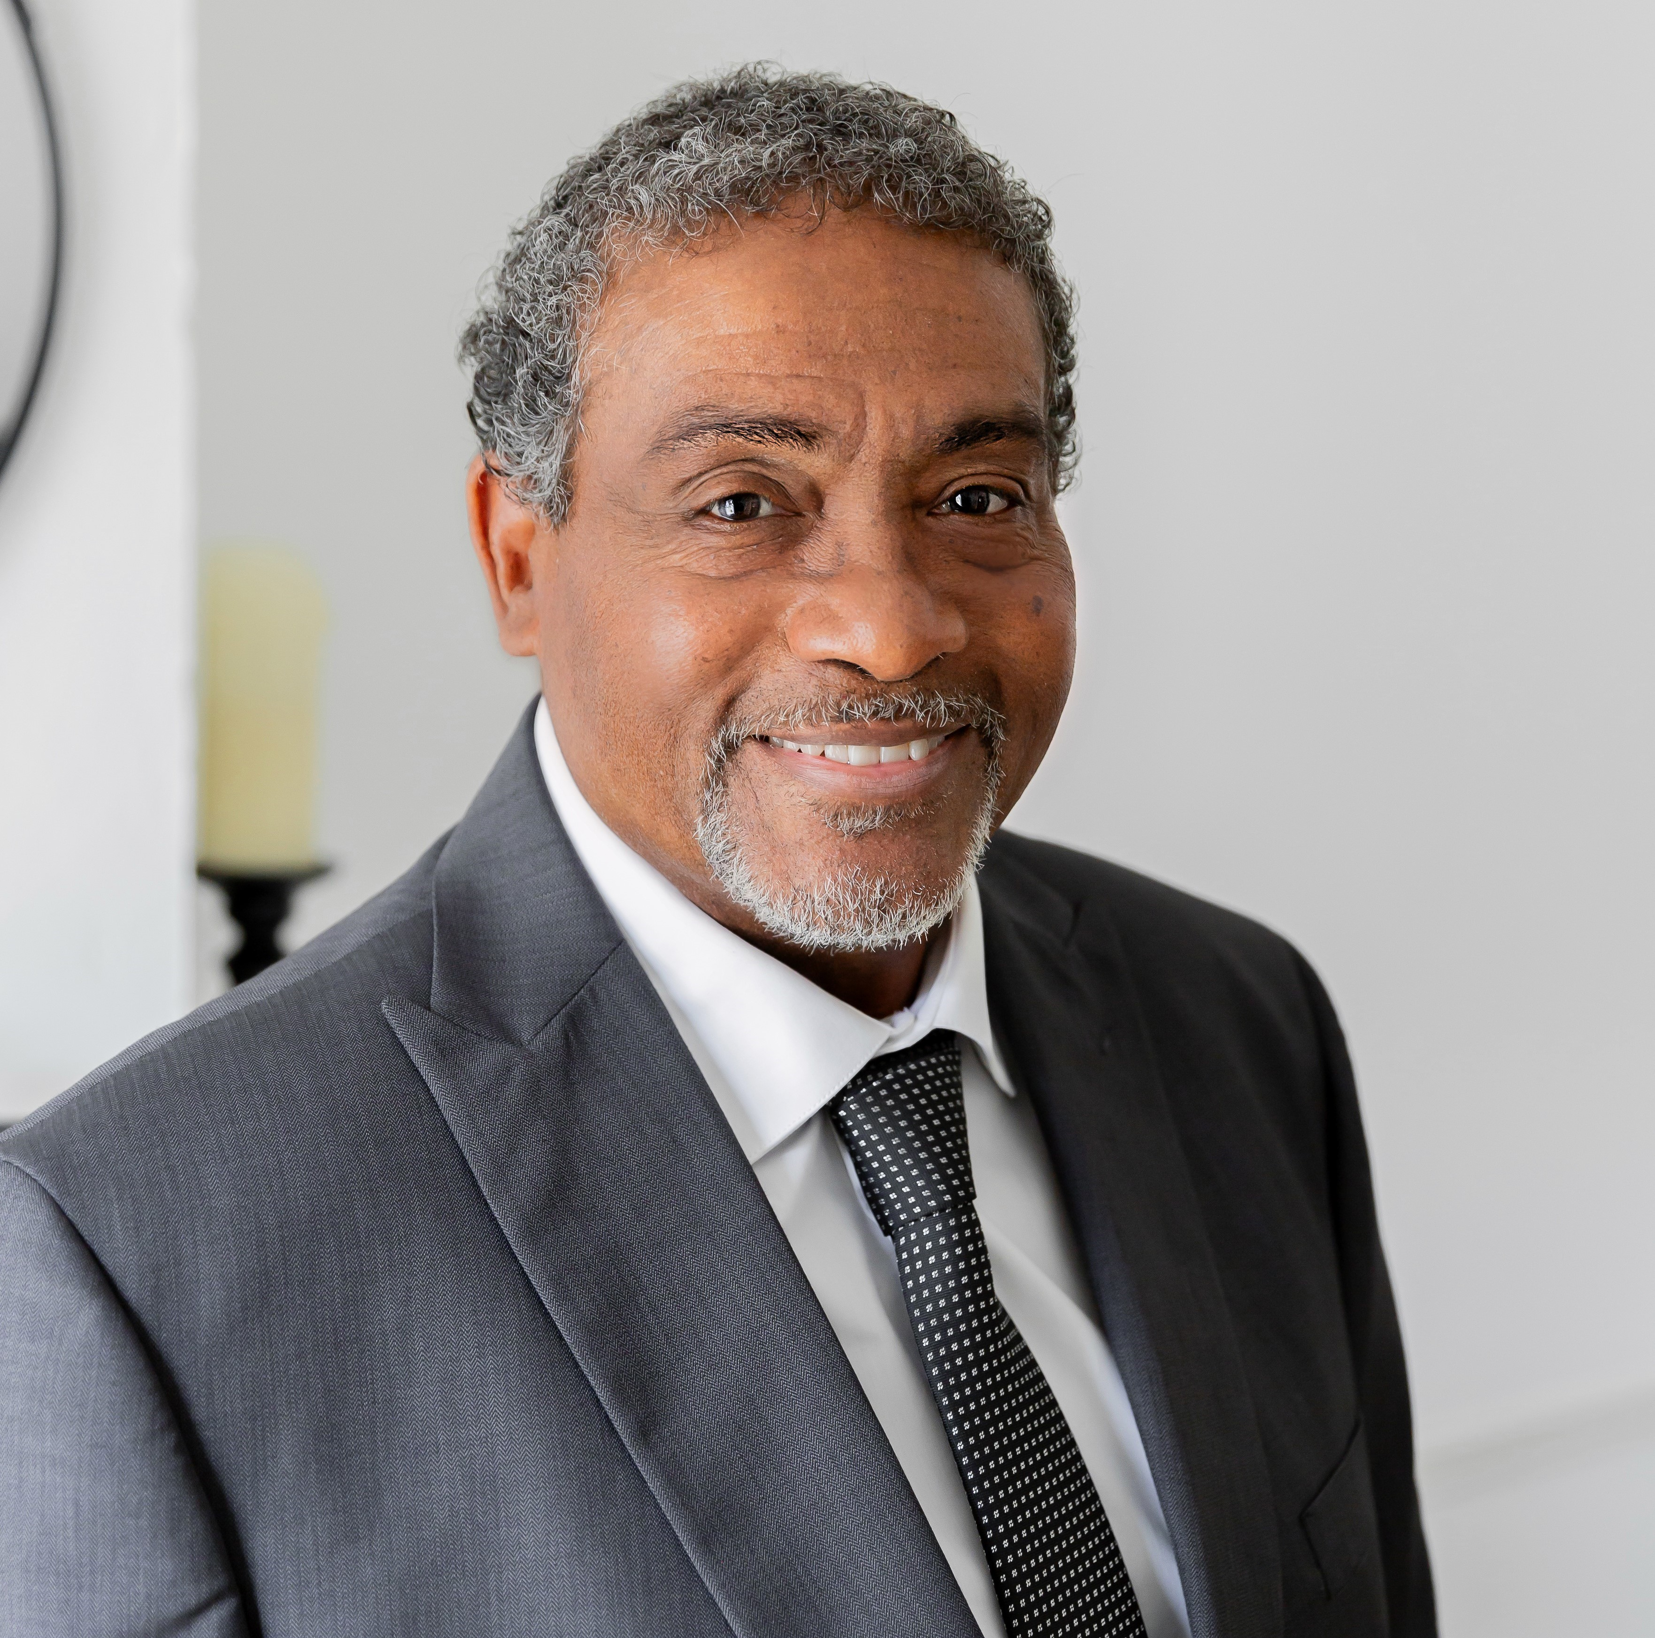
.
Board of Trustees
Steve Hipes, Chair
Victoria County
Melissa Lester, Vice-Chair
Calhoun County
Dr. Sylvester Walleck, Secretary
Jackson County
Judge Daryl Fowler
DeWitt County
Jeana Bethany
Calhoun County
Edward Ousley
Goliad County
Corey Wasicek
Refugio County
Gary Burns
Victoria County
Sheriff Micah Harmon
Lavaca County
Sheriff Justin Marr, Ex-Officio
Victoria County
Sheriff Carl Bowen, Ex- Officio
DeWitt County

Slide 9
What we offer
How we got here
What keeps the doors open
What we offer

Slide 10
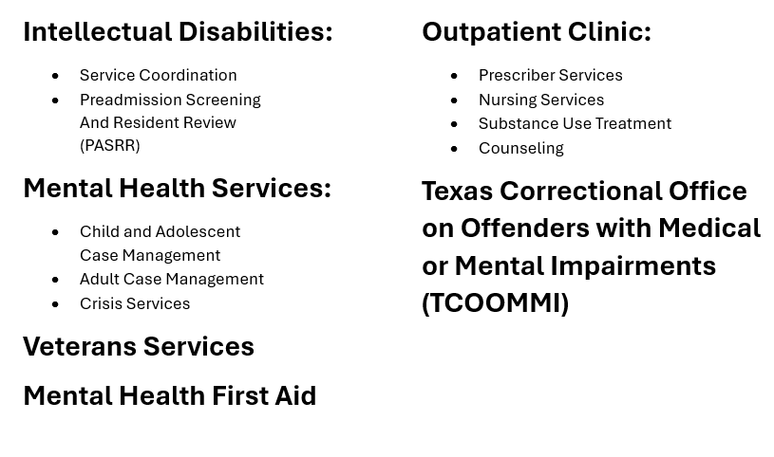
Community Based Services

Slide 11
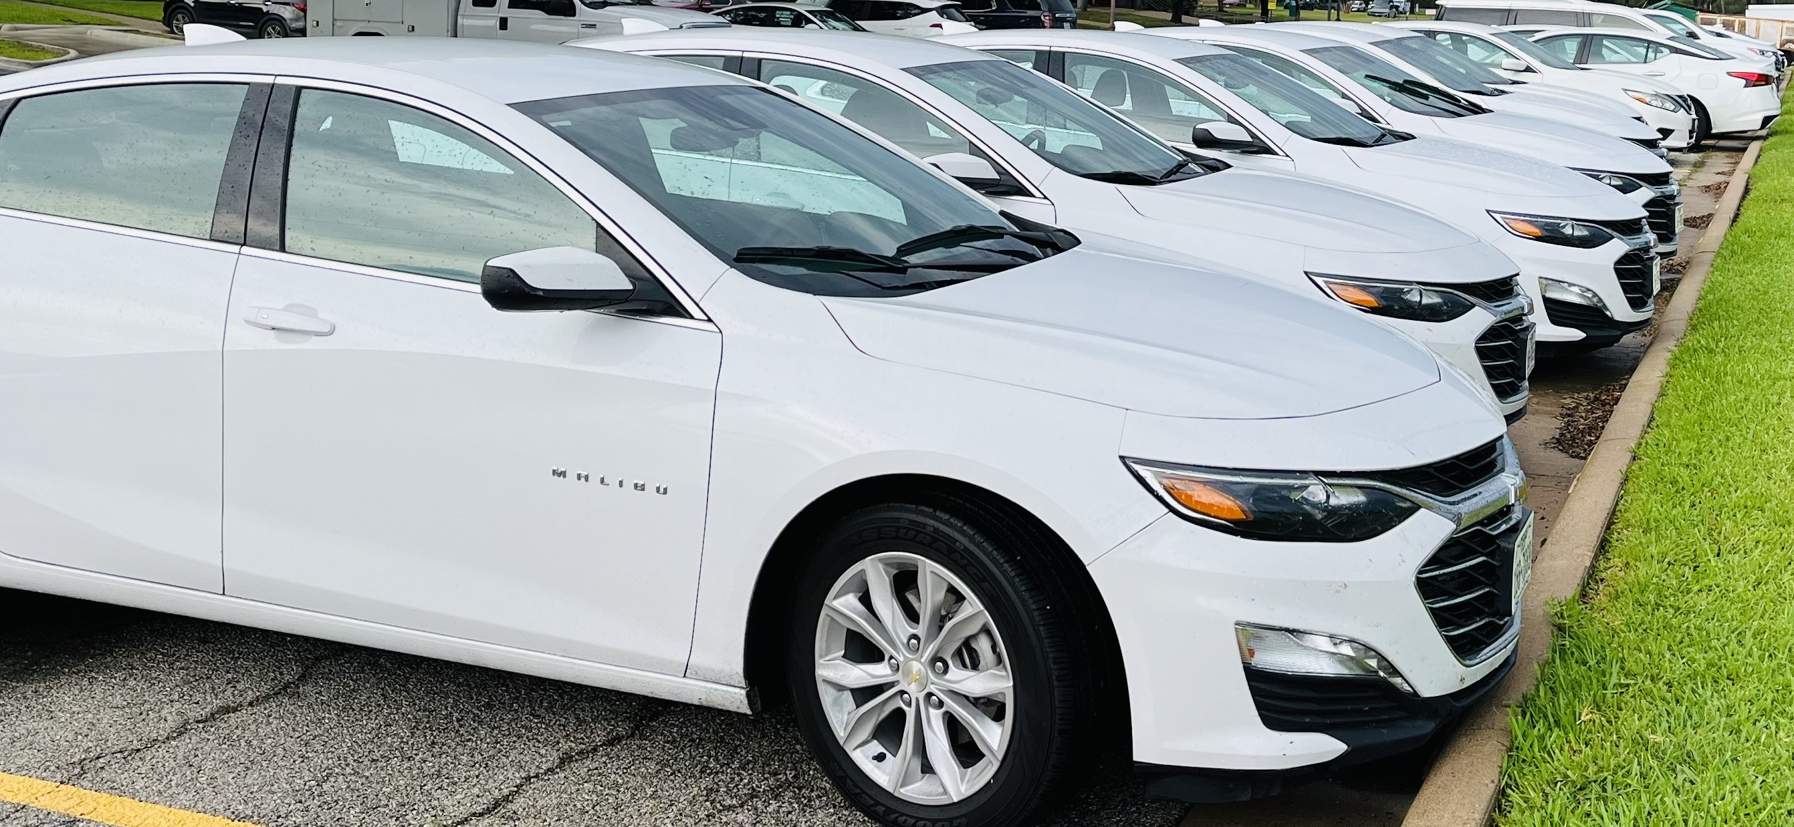


Slide 12
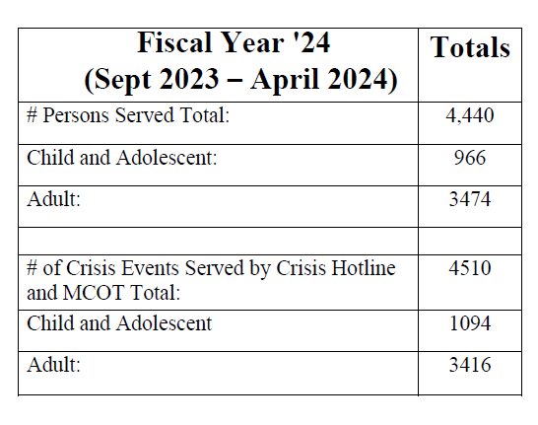
.
Seven County Service Data

Slide 13
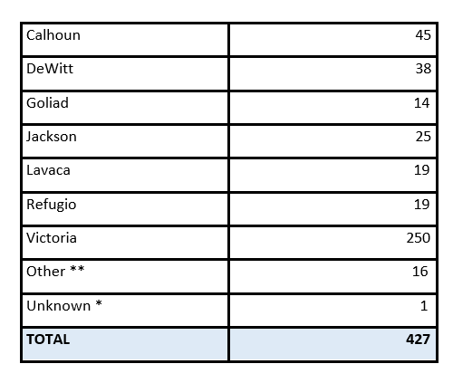
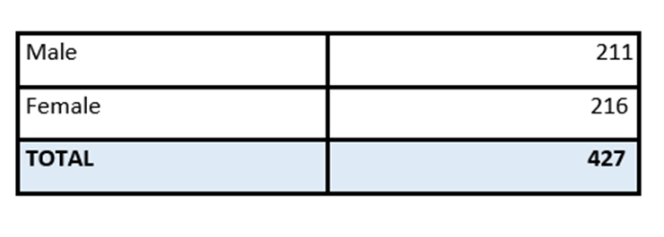
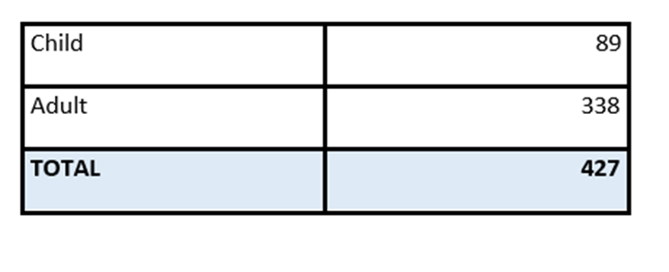
Hospitalization Statistics
September 2023 – February 2024
* Not Documented in Spreadsheet
** Outside Catchment Area

Slide 14

The Value of the Gulf Bend Regional Community Collaborative:
Diversion Services
  Community Response Team (CRT)
  Continuity of Care Services in the Jail
  Crisis Case Manager based in Citizens Emergency Room on the weekends.
Bend the Trend (VISD)
Jail in Reach: Forensic care for county jail inmates.
$40 Million for Mental Health 60 Bed Inpatient Hospital (Civil & Forensic)
.

Slide 15
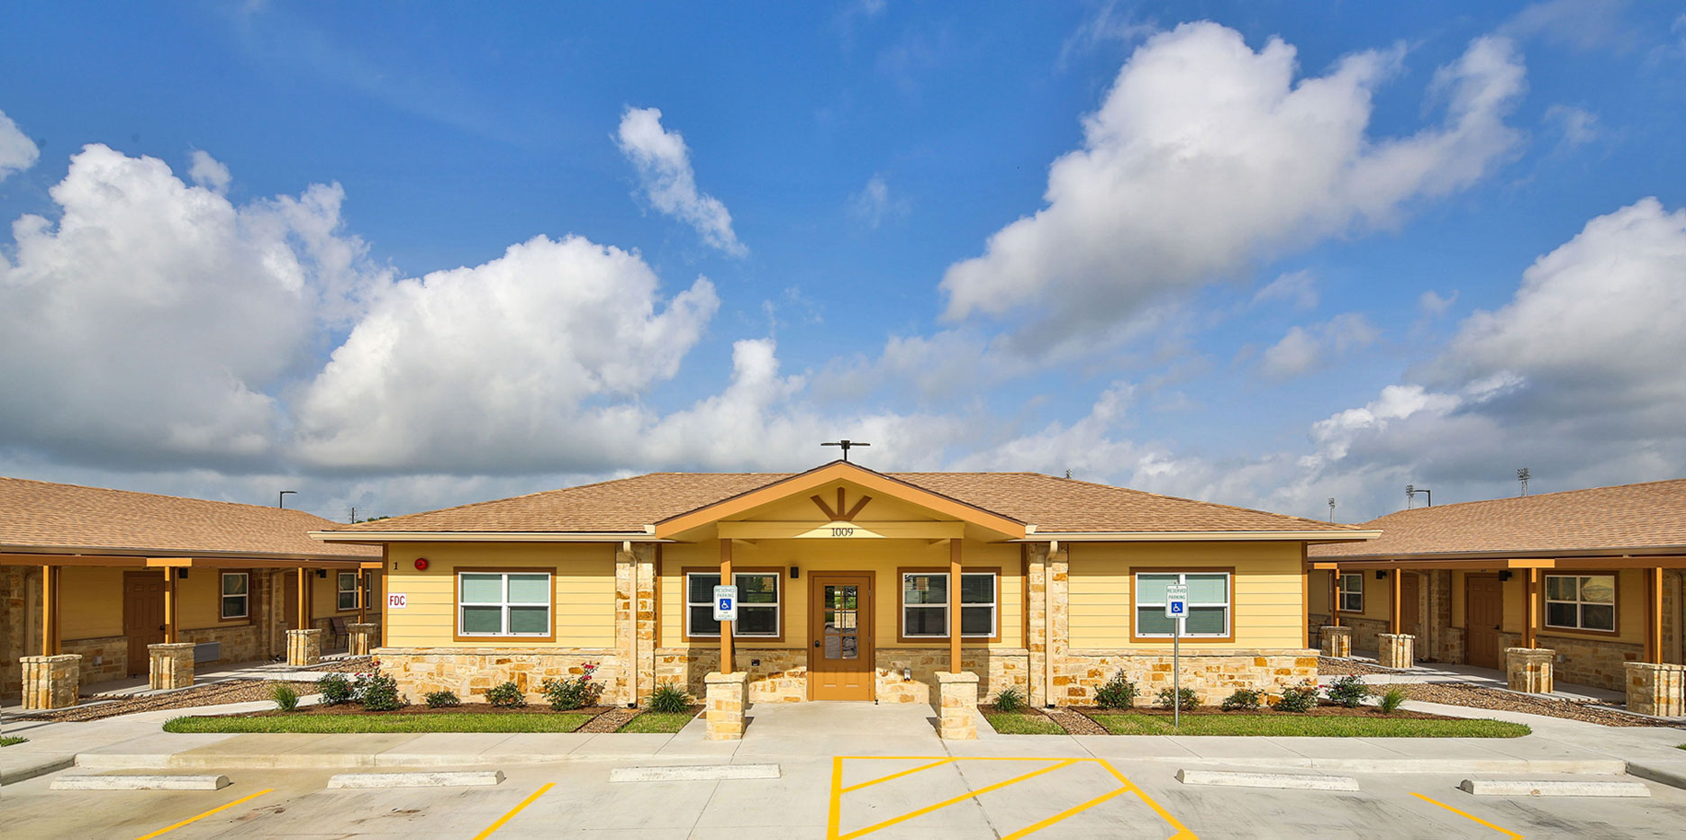
Wellness Community
The Wellness Community is a 32-unit single occupancy apartment complex for individuals with mental health and intellectual disabilities. It is owned and operated by Gulf Bend Center.
1009 N. Nimitz
Victoria, TX 77901

Slide 16
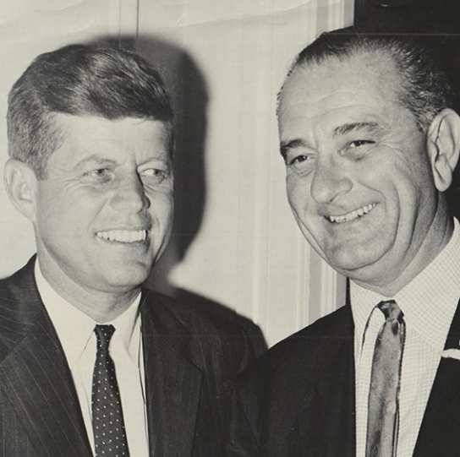
What if Texas didn’t establish and fund a “system of care” for mental health and intellectual disabilities?
What would our community be willing to financially support a “system of care?”
.

Slide 17
“The Wellness Community has made me feel like part of a community. Everyone is supportive and friendly. They provide resources, like the food pantry, transports, and a safe environment. An overall blessing.”
-Resident
“I’ve been doing really good instead of bad. So now I’m talking about my future. I have a big future ahead of me and a lot of thing that are going well.”
-Elementary Student
"As Jackson County Judge, I am grateful for the collaboration that we have with Gulf Bend. Over the last few years we have been successful in identifying and treating our inmate population that suffers from mental illness. This has been a tremendous benefit for the individual and the justice system. Normally, these issues would be addressed at the state hospital, but by working together, Jackson County and Gulf Bend have been able to resolve most of these challenges at home. For a rural community like ours, we are definitely proud of this achievement and very much appreciative of the help.“
-Judge Jill S. Sklar, Jackson County Judge
“The relationship we have with Gulf Bend is incredible. The support we get from them improves our child’s life and our family every day.”
-Parent
“One of the services that has benefited us most is when a case worker comes in the home and visits with our child and visits with us as well.”
-Parent

Slide 18
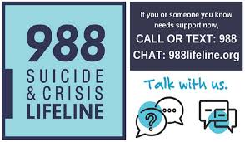
24- Hour Crisis Hotline:
(877) SAFE GBC
(877)732-3422

Slide 19


Questions?
www.gulfbend.org

